Slide 1
Sensing conducted EMI in power lines for appliance disaggregation
Highlights: Overview of NILM, Past work, Conducted EMI as a unique/deterministic aspect
Manoj gulati
Advisers: Dr. Amarjeet Singh and Dr. Shobha Sundar Ram
Discussion: Prof. Dr. G. Bhuvaneshwari

Slide 2
Overview of NILM
Term: Non-Intrusive load monitoring (Origin 1981’s G.Hart NILM paper)
Goal: Disaggregating different electrical appliances being operational in a building/home using a single point sensing solution.
Motivation:
Reduce energy consumption in buildings by turning off ‘non-critical’ appliances.
Provide appliance level energy consumption data to end consumer similar to telephone bill.
Provide a feedback to grid/utilities about type of appliances being in use versus time of day.

Slide 3
Previous approaches in NILM
Several electrical parameters like real power, reactive power, phase, current are used for disaggregation.
Sampling rates are around 1 Hz and data is taken from a single point home/building level smart meter.
After retrieving data at 1Hz several machine learning approaches like state based models are applied to disaggregate/differentiate between appliances being operational (time domain).
These approaches are widely used with ability to disaggregate 70-80% of appliances (mostly power loads).
Fails with complex appliances like SMPS driven appliances.

Slide 4
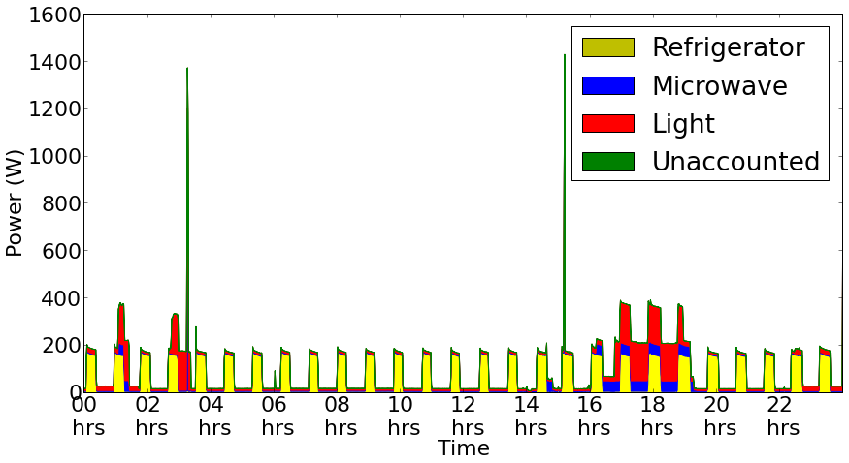
Insights in to NILM
Image taken from NILM work done at IIITD

Slide 5
Recent work in NILM
ElectriSense (2010): Using conducted EMI as a unique/distinguishing signal for disaggregation.
Time domain signal for complex appliances is usually time-variant and hard to model but frequency domain HF EMI provides a deterministic signal.
Able to differentiate among most of the complex appliances due to different switching frequencies of SMPS.
Sampling rates are around 1Mhz (STFT was applied for analysis).

Slide 6
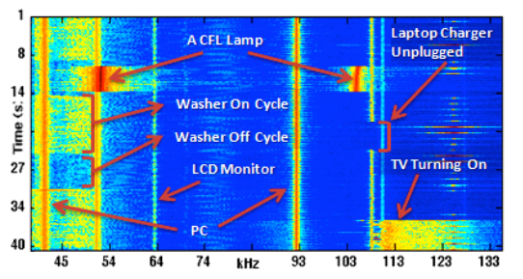
Frequency spectrogram

Slide 7
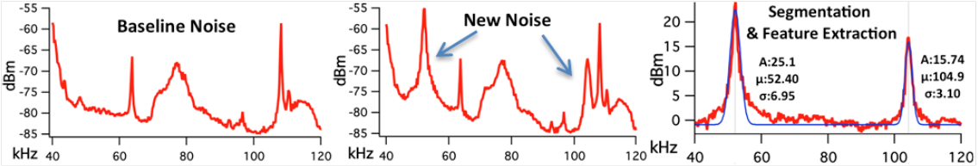
Appliance level modeling for EMI trace using Gaussian curve fitting

Slide 8
Proposed work
To study unique and distinct features in conducted EMI generated by multiple electrical appliances.
Specific test cases:
Study impact of voltage fluctuations & building architecture on CE.
Study dissimilar features in CE during w/ and w/o load.
Study effect on CE of a single SMPS(EUT) for different loads.
Analyze features and unique aspects in CM CE and DM CE for different electrical loads.
Analyze response of EMI (constructive/destructive interference) w/o LISN.
*CE Conducted EMI *CM Common mode *DM Differential mode

Slide 9
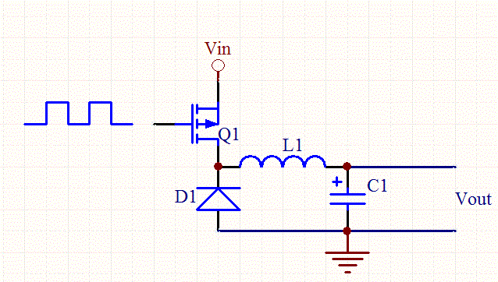
Simple Buck Regulator (Open-loop)
Image Courtesy:
http://www.daycounter.com/LabBook/BuckConverter/Buck-Converter-Equations.phtml

Slide 10
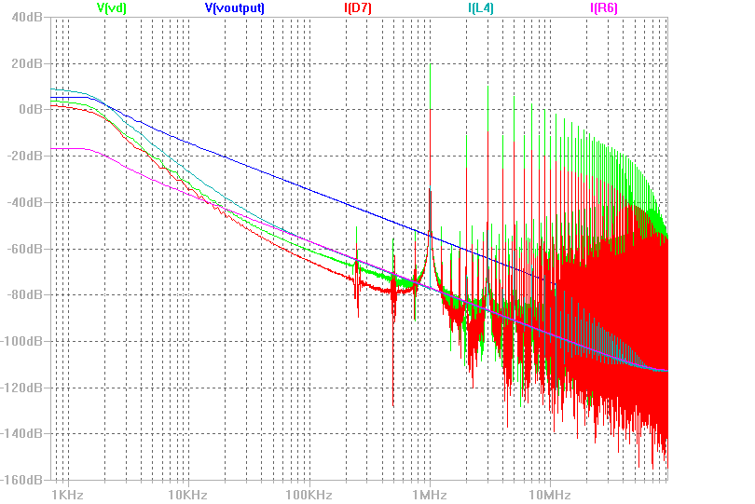
Frequency Domain Analysis

Slide 11
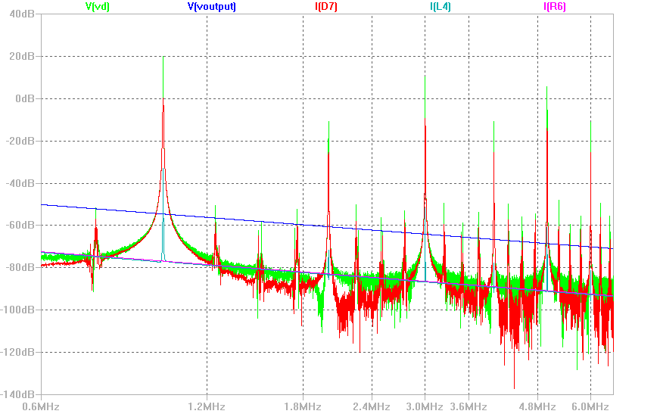
Frequency Domain Analysis

